Slide 1
St David’s Day Collecting Game
Wokingham Library Code Club

Slide 2
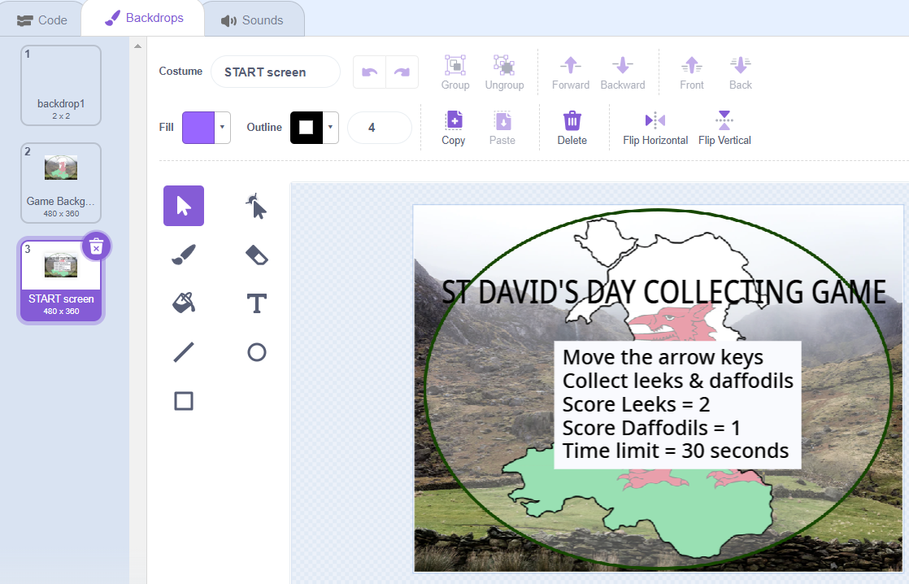
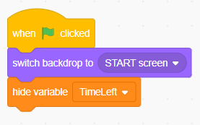
Starting Screen

Slide 3

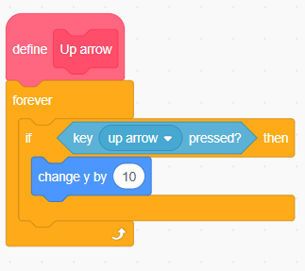
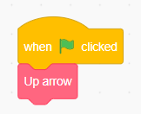
St David Sprite – Using My Blocks to move using the arrow keys

Slide 4
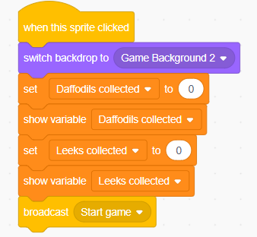

Starting the Game

Slide 5
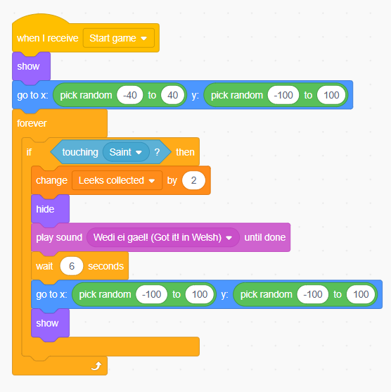
Collecting items – leeks & daffodils
What does this code do?
Show the item
Make the item go to random spots
Make a condition when St David touches the item
Change the score variable
Hide
Play Welsh response
Wait
Show in new random position

Slide 6
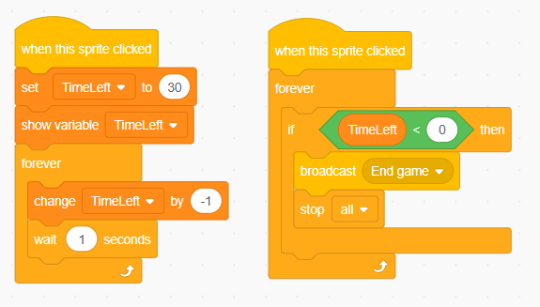
Setting a time limit with a “time left” variable

Slide 7
Remember to
save and test each bit of code as you go
debug if things aren't working as you expect
think through what you want to happen
check hide and show or go to if things aren’t where they’re supposed to be

Slide 8
When you have finished the coding…
You could try changing or adding to the things the dragon says
You could add another level
You could make your own version of a collecting game – about anything!

